Slide 2
Who is MHI?
MHI’s mission
To provide and promote safe, affordable, and well-maintained housing in inclusive communities, and to mobilize resources for these purposes.
MHI Members are faith groups
80+ member faith groups, including Baha’i, Christian, Jewish, Muslim, and Hindu. Our volunteers come from both civil and religious society.

Slide 3
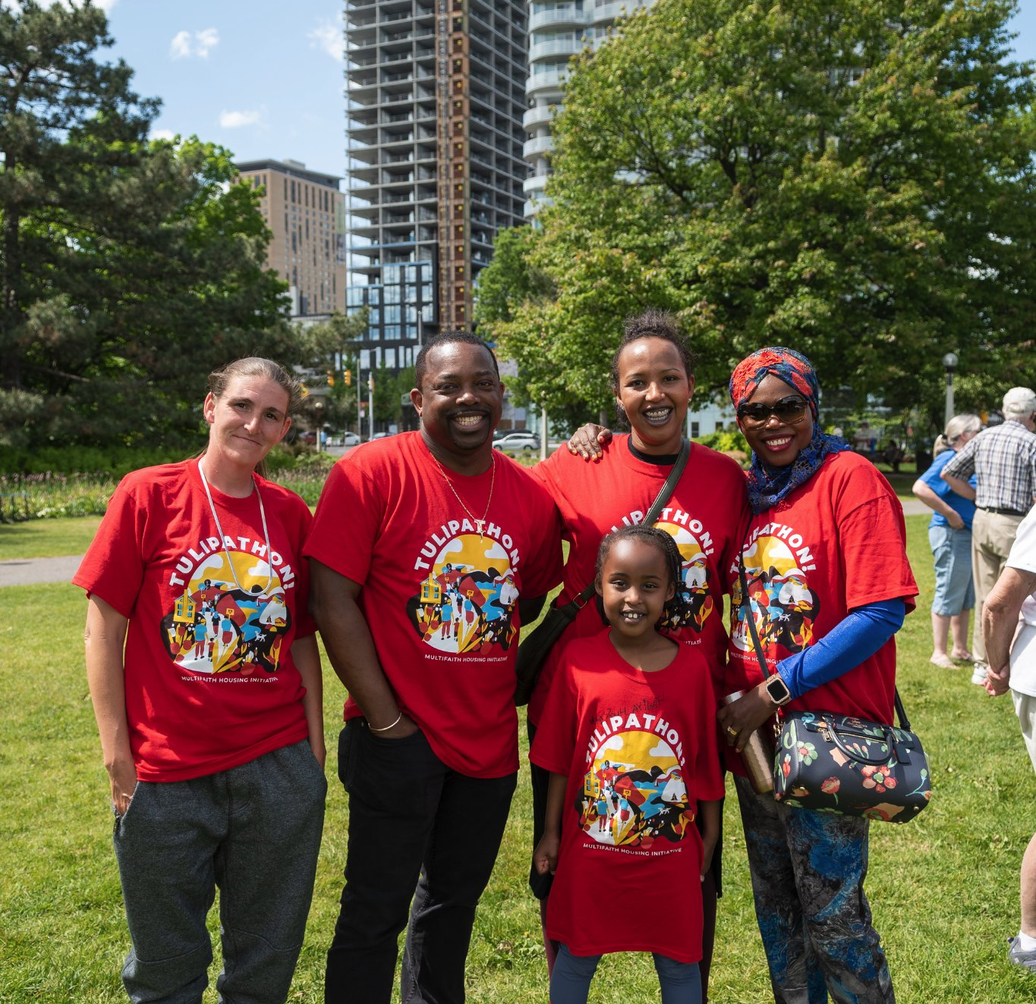
How many people live in MHI residences?
139 rental units
300-400 residents

Slide 4
Multifaith Housing has 4 housing properties
Kent House Centretown
Blake House Vanier
The Haven Barrhaven
Somerset Gardens Centretown

Slide 5
MHI builds communities that are:
safe
affordable
inclusive
economically diverse
welcoming
community-oriented
responsibly dense
transit-oriented

Slide 6
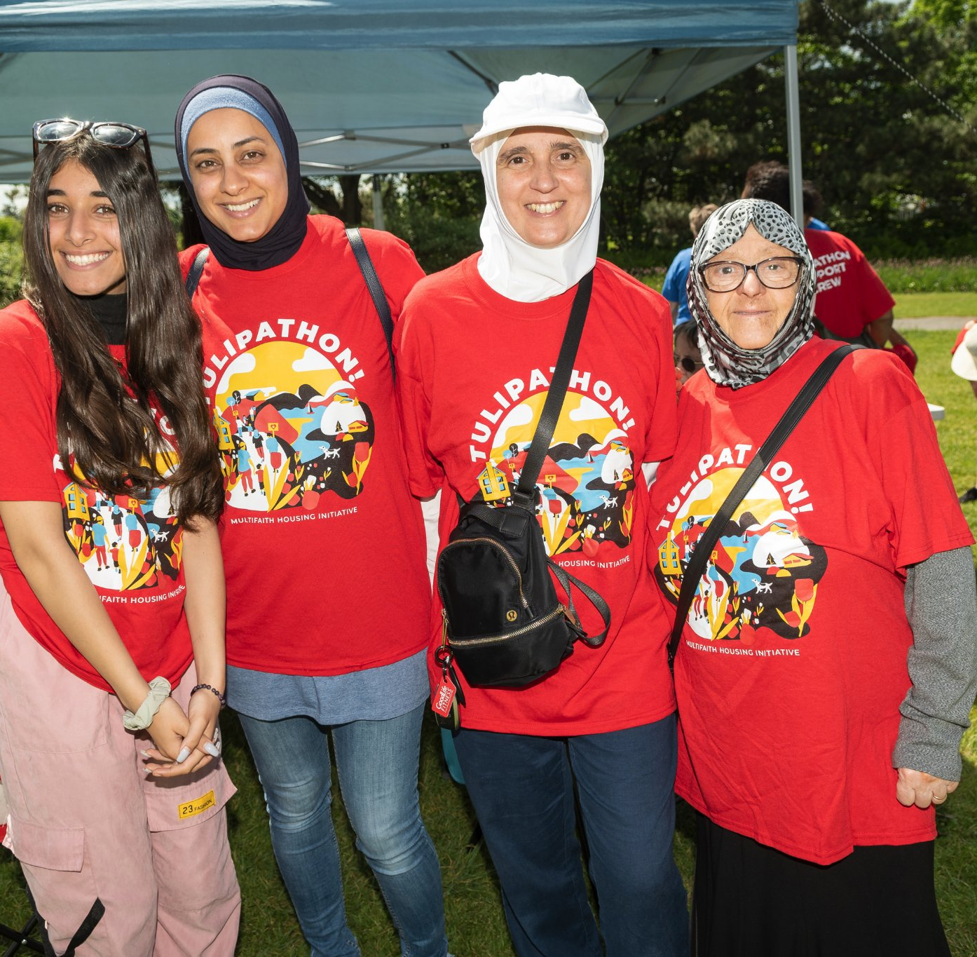
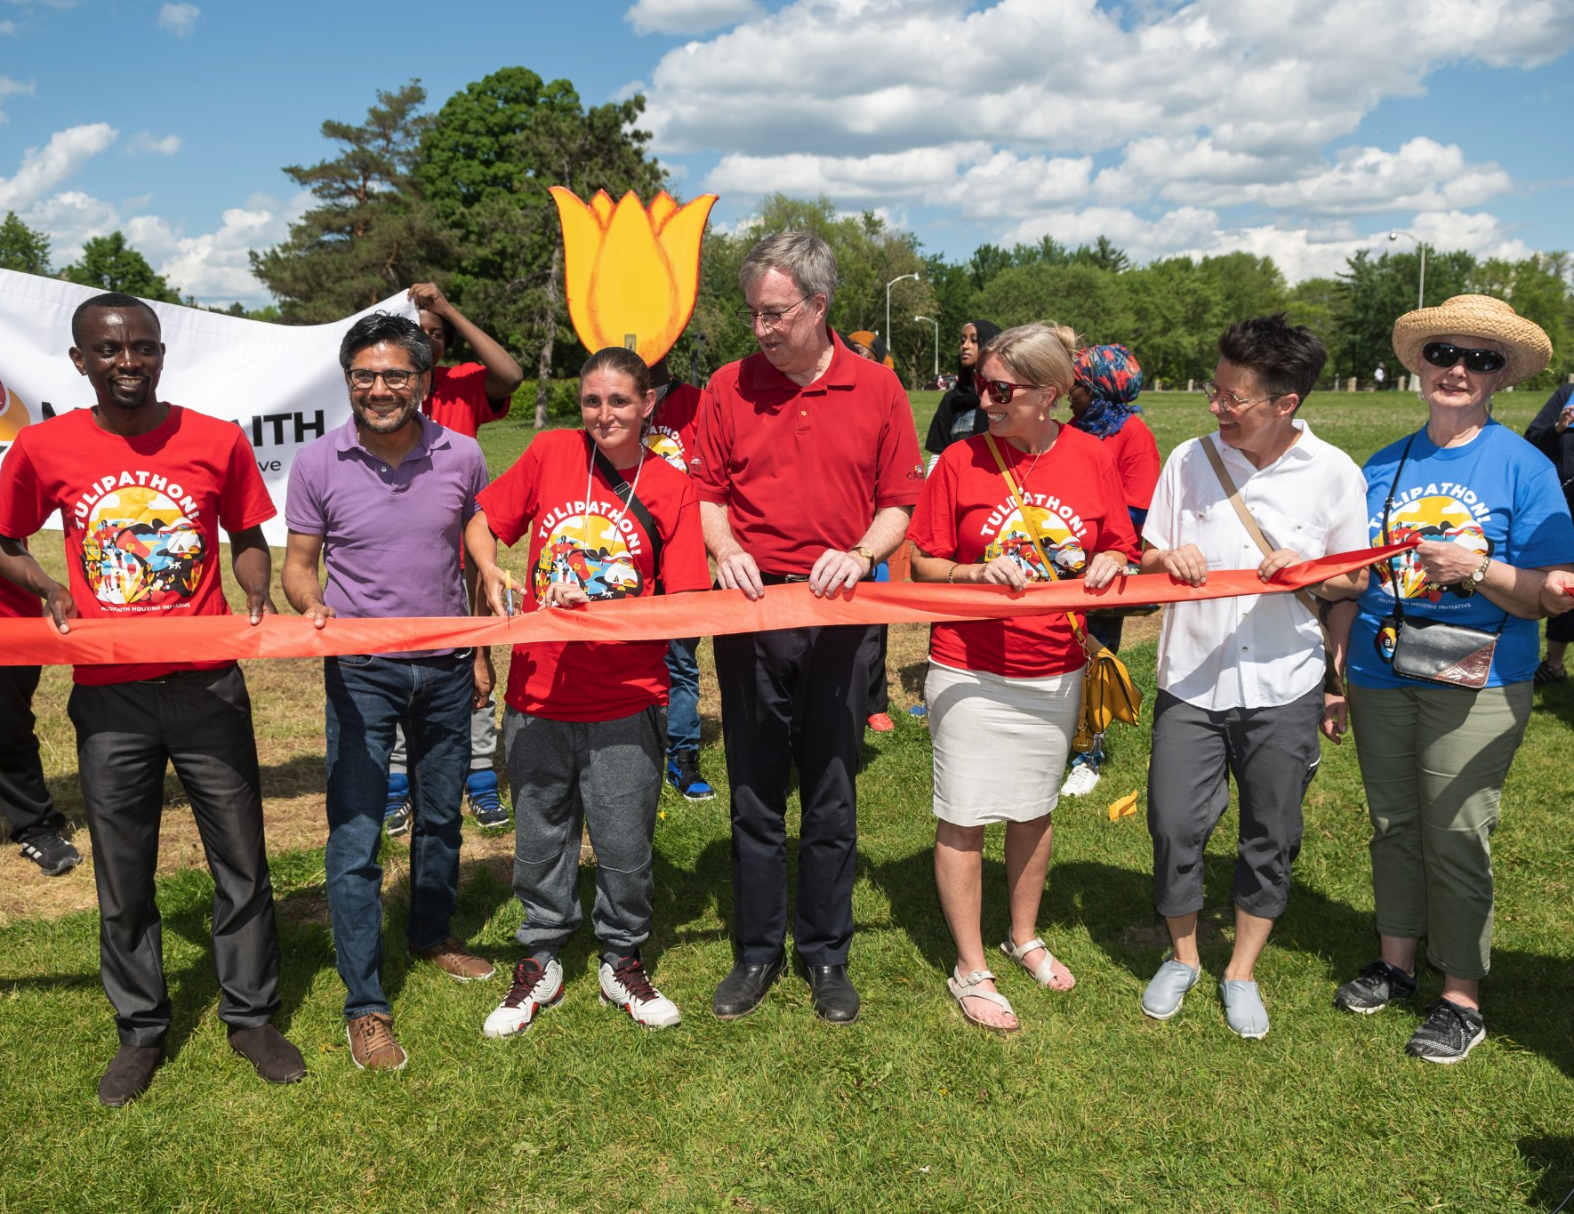
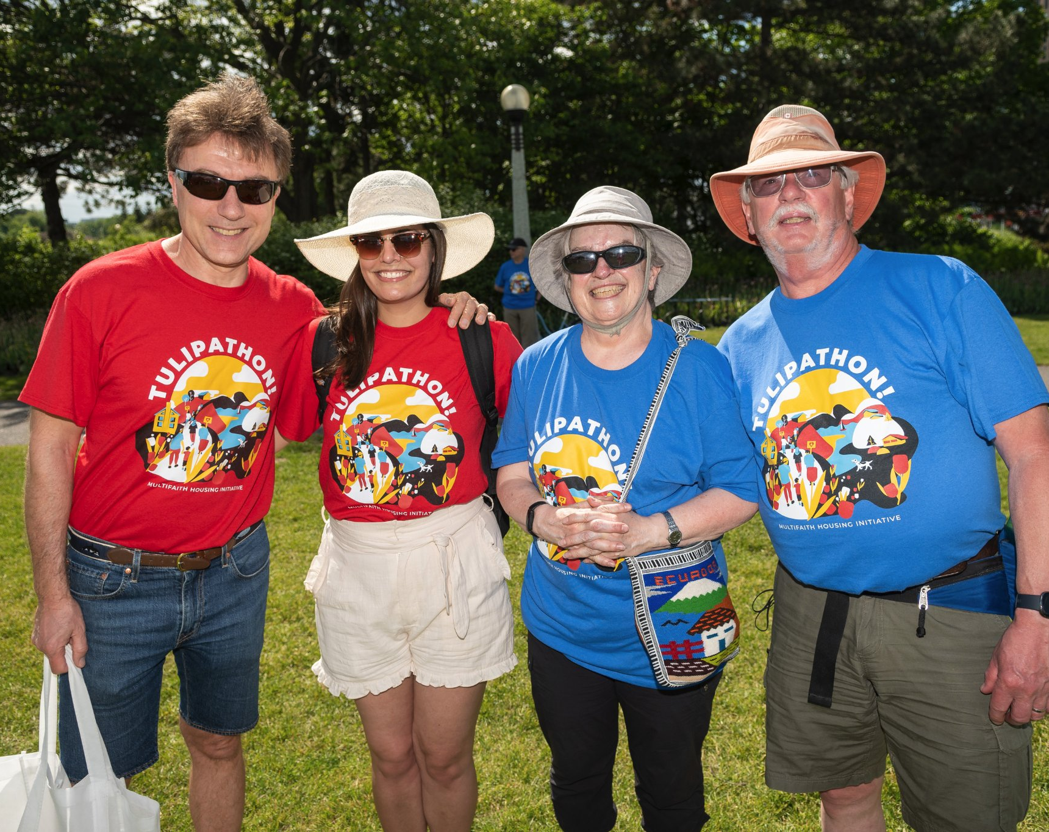
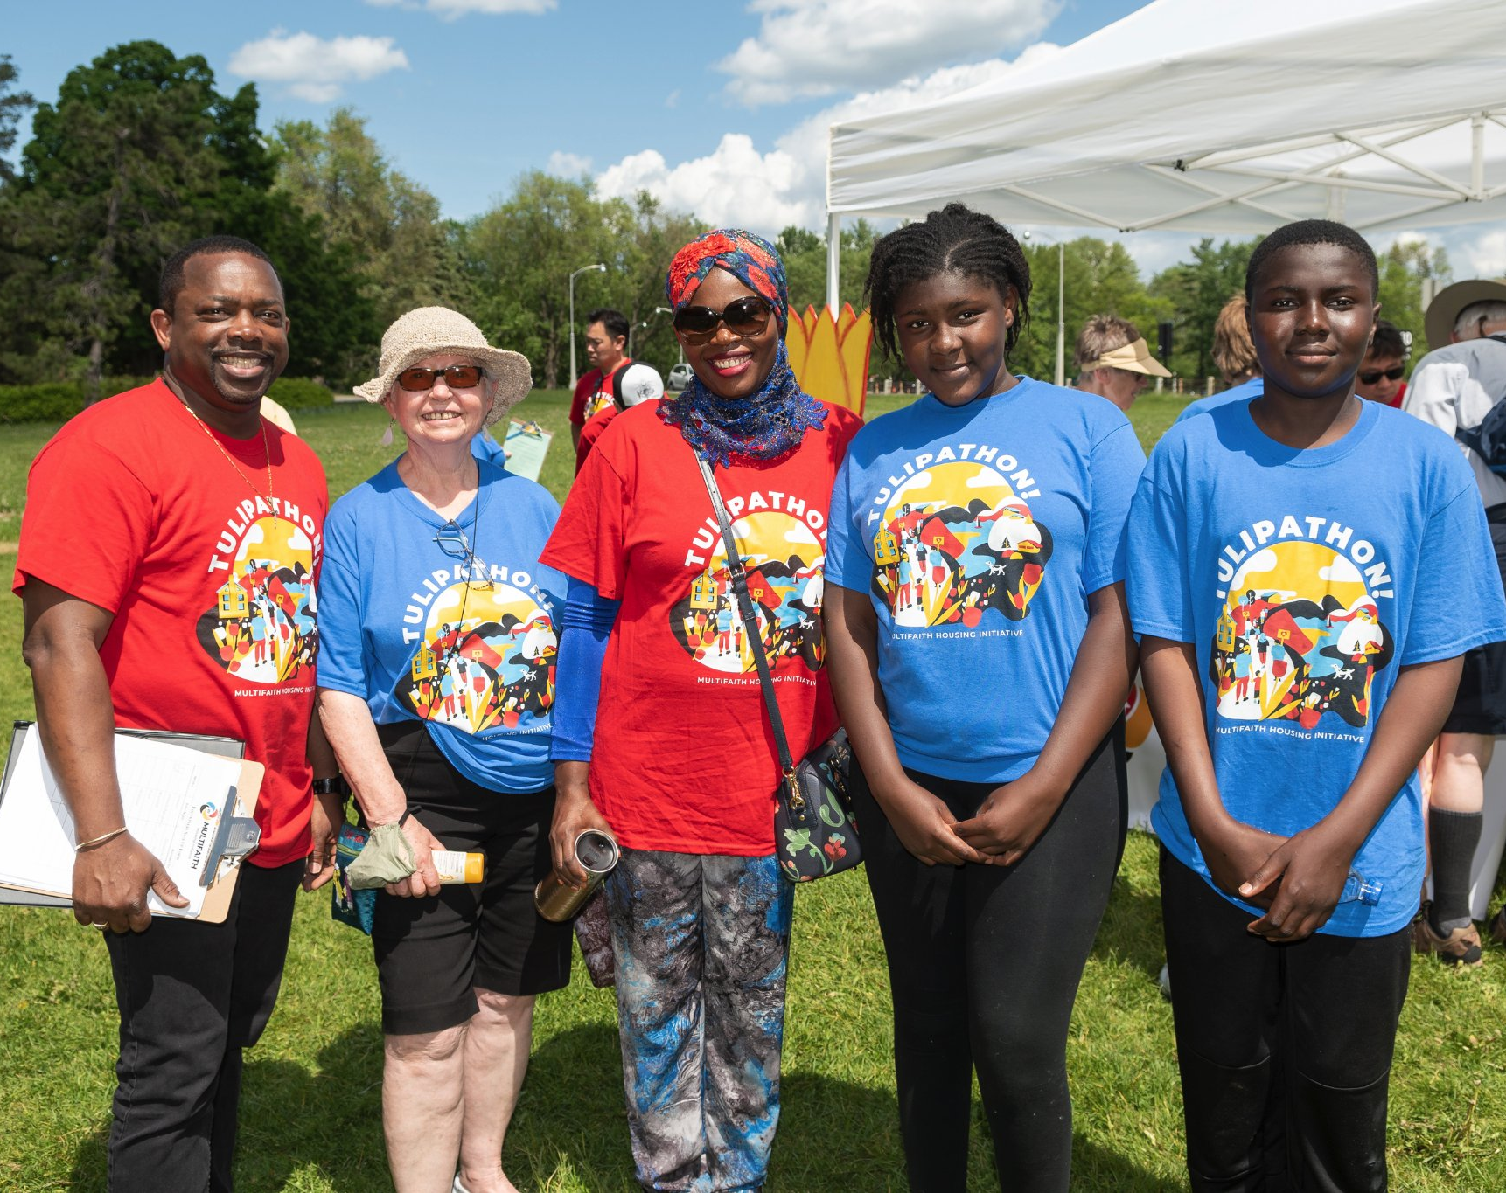
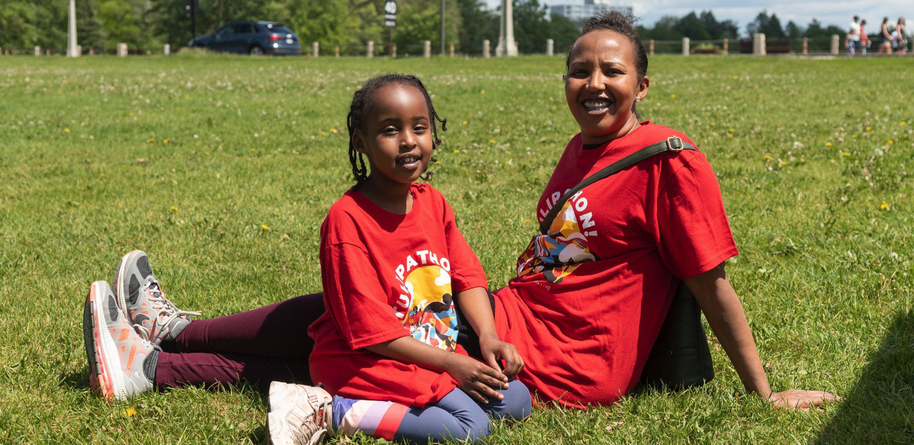
What is Tulipathon?
Fundraiser that starts online after MHI’s AGM
MHI’s single-biggest fundraiser
All proceeds go to MHI’s subsidize program which provides MHI’s tenants with a little extra help on their rent
A celebratory walk tales place halfway through the fundraiser to bring together MHI faith groups, fundraisers, and volunteers
The walk is May 28th 2:00 PM at Commissioner's Park (Dow’s Lake)
Brings together MHI faith groups & volunteers
Fundraising ends on June 30th

Slide 7
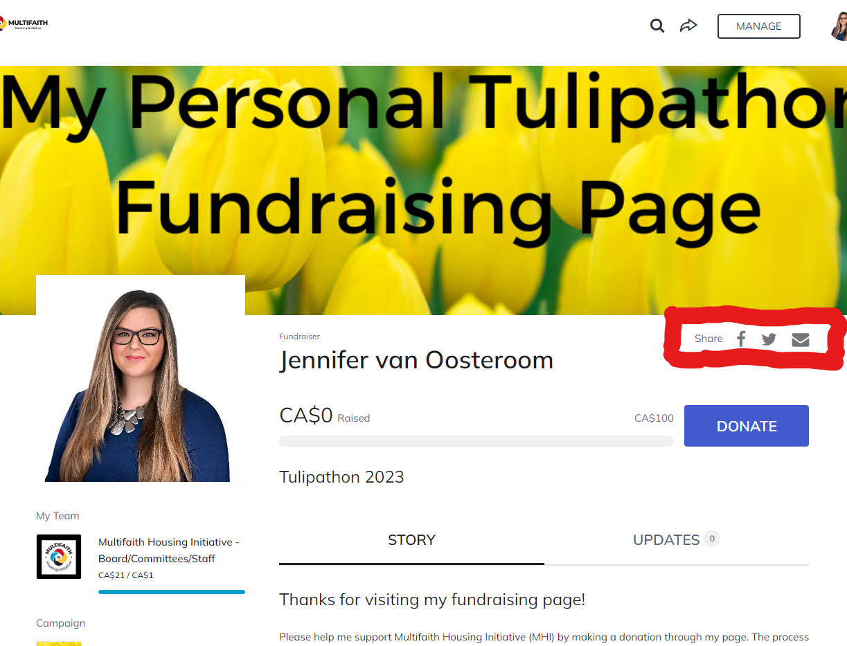
Fundraising for Tulipathon
4 methods to fundraise
online
cheque
cash
phone

Slide 8
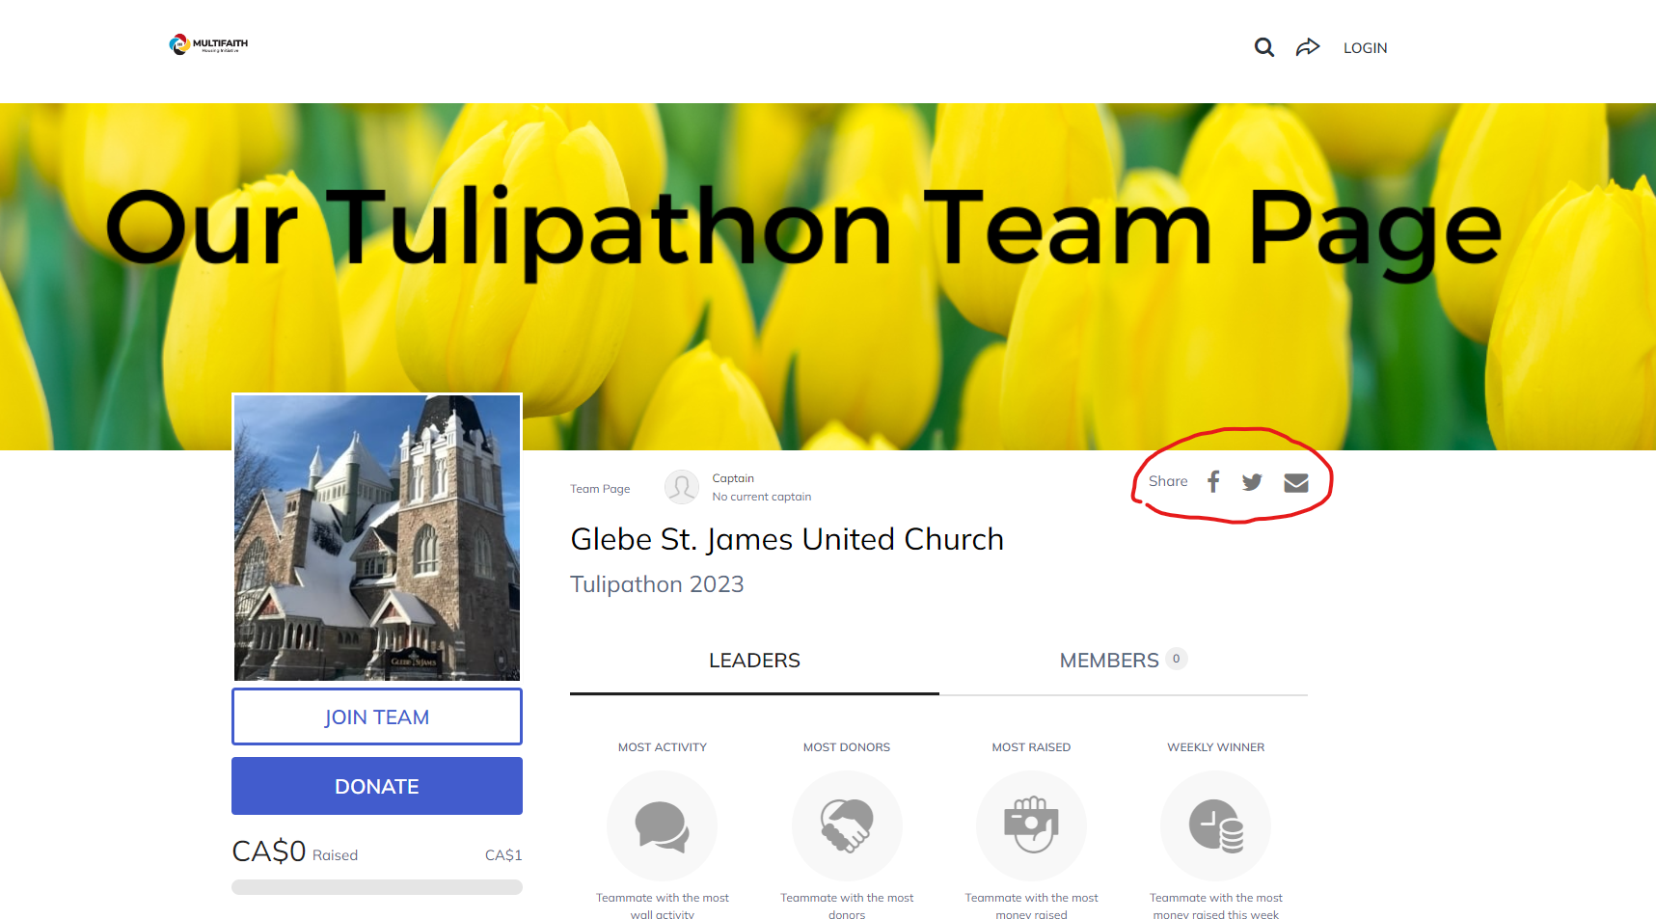
Fundraising for Tulipathon: online
Best way to donate to #tulipathon2023
You can donate, become an individual fundraiser, or join your faith group’s Team
Find all information on how to donate and the Team directory at www.multifaithhousing.ca/tulipathon

Slide 9
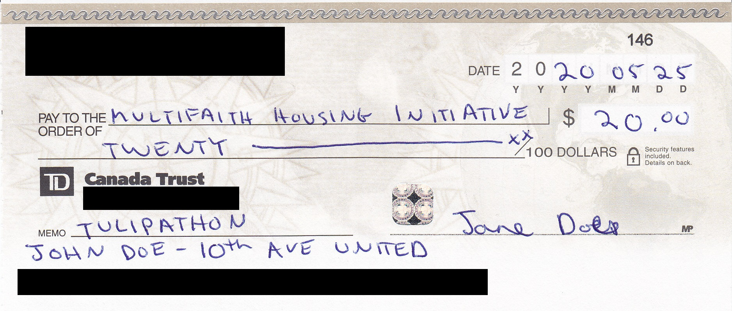
Fundraising for Tulipathon: cheques
Got cheques? Please either:
Best way: Get your donors to mail directly to us:
206-404 McArthur Ave., Ottawa, ON, K1K 1G8
Collect the cheques yourself and mail them to us – If you have multiple cheques, use downloadable pledge form: www.multifaithhousing.ca/tulipathon

Slide 10
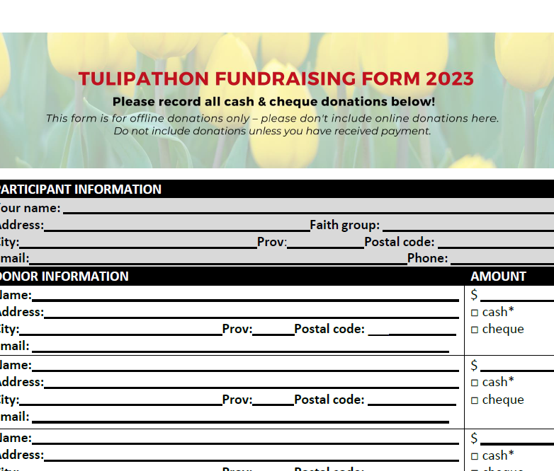
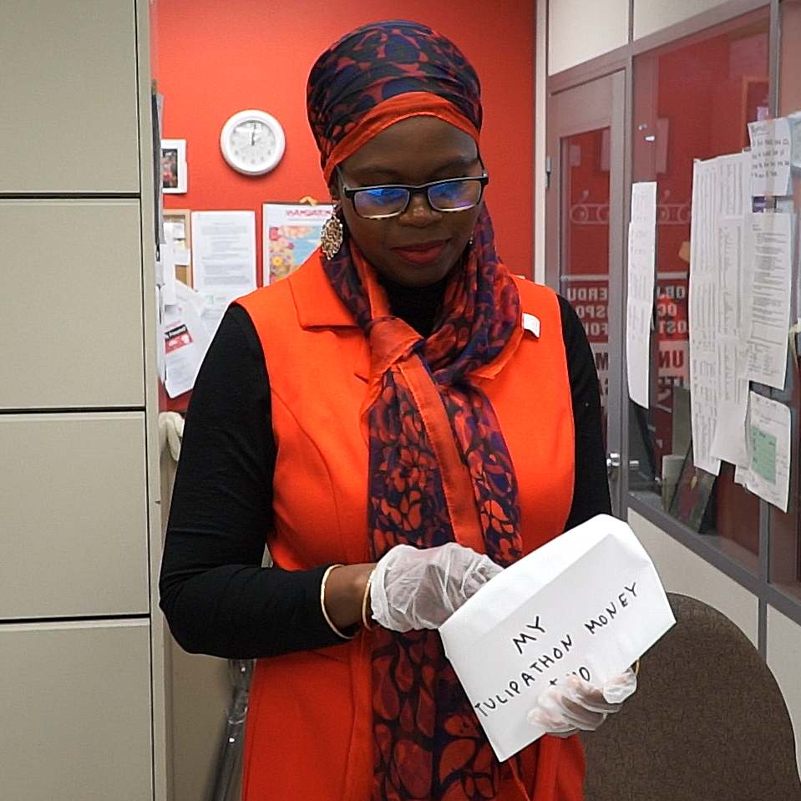
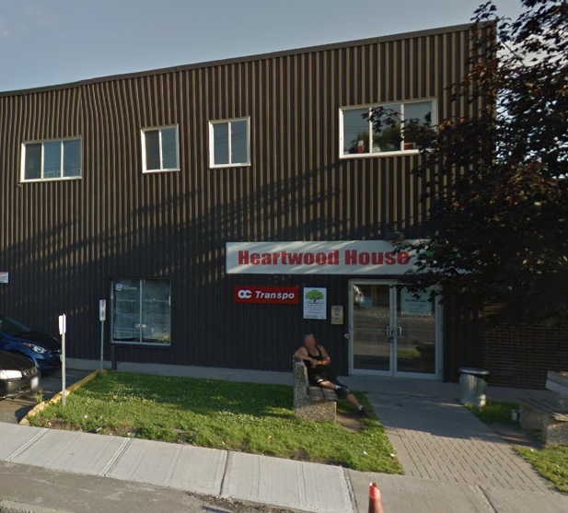
Fundraising for Tulipathon: cash
Do not put cash in the mail. Instead, either:
Make an appointment – Fill out the pledge form, put all cash and cheques in an envelope, and call 613-686-1825 to make an appointment for MHI to receive your donations at our Vanier offices (Heartwood House, 404 McArthur Ave.).
Save yourself a trip – Write out a personal cheque from your own personal account for the amount of cash received. Mail your pledge form, your cheque, and any additional cheques to 206-404 McArthur Ave., Ottawa, ON, K1K 1G8.

Slide 11
Fundraising for Tulipathon: phone
Donate by credit card at 613-686-1825.
Donors should indicate if they want to support a walker/team.
Please leave voicemail if nobody picks up!

Slide 12
Deadline to submit Tulipathon money
Friday June 30, 2023

Slide 13
“Where can I find MHI on social media?”
MHI Twitter: @MHIOttawa
Veterans’ House Twitter: @VetsHouseCan
MHI Facebook: /MHIOttawa
Veterans’ House Facebook: /veteranshousecanada
MHI YouTube: MHI Ottawa
MHI LinkedIn: Multifaith Housing Initiative

Slide 14
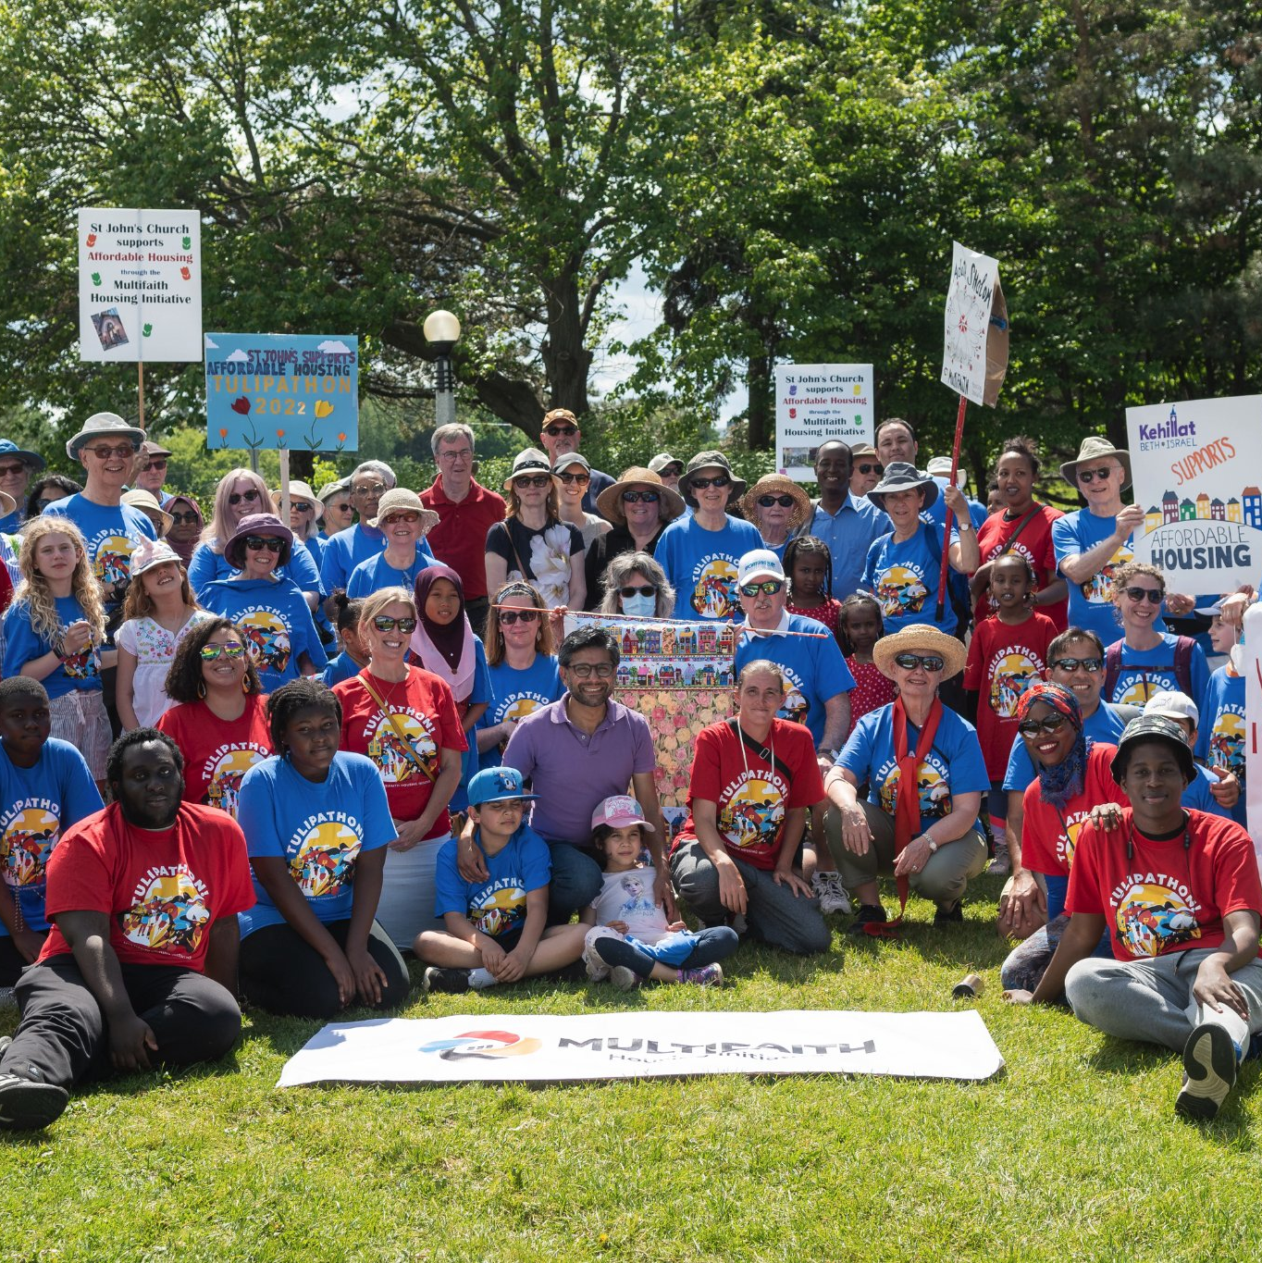
Thank you!

